Slide 1

Northeastern University - Seattle
CS6650 Building Scalable Distributed Systems
Vishal Rajpal

Slide 2
Week 9 – Scaling the Data Layer - Fundamentals
Topics we will cover today:
Scaling Databases
Moving to NoSQL
Partitioning
Replication
CAP Theorem

Slide 3
Scaling Databases
Relational Databases
Established database management system technology
Relational model based on defined schemas and SQL query language
Highly optimized, stable technologies
Scale up easily by running database on bigger machines
More memory, CPUs, disks
Many commercial/open source implementations
Distributed Databases
Evolution of databases to handle large amount of data
Support varying requirements
Consistency vs Availability

Slide 4
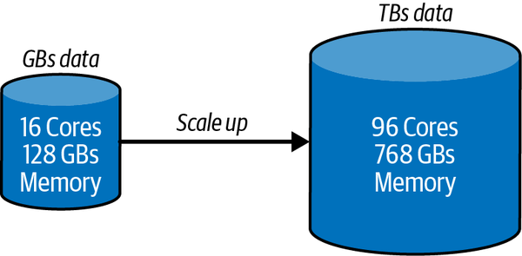
Scaling Databases
Scaling Relational Databases
Scale Up
Designed to run on a single machine.
Use a more powerful machine
Downsides
Cost
Licensing
Powerful hardware costs
Availability
SPoF
Custom High Availability (HA) Solutions.
Growth
Migration to powerful hardware is Inevitable if database continues to grow.
Notes:
Relational databases were designed to run on a single machine, which enables shared memory and disks to be exploited to store data and process queries.
This makes it possible for database engines to be customized to run on machines with multiple CPUs, disks, and large shared memories.
Database engines can exploit these resources to execute many thousands of queries in parallel to provide extremely high throughput.

Slide 5
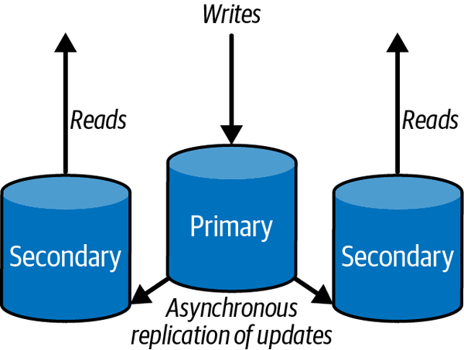
Scaling Databases
Scaling Relational Databases
Scale Out
Read Replicas
Common first step.
Advantages
Effective to scale read request load
Reduce load on primary to create more write capacity
Reads still possible if primary unavailable
Disadvantages
Inconsistency window between primary and secondaries
Potential stale reads
Notes:
A common first step to increasing a database’s processing capacity is to scale out using read replicas.
You configure one or more nodes as read replicas of the main database.
The main database node is known as the primary, and read replicas are known as secondaries.
The secondaries maintain a copy of the main database.
Writes are only possible to the primary, and all changes are then asynchronously replicated to secondaries.
Secondaries may be physically located in different data centers or different continents to support global clients.

Slide 6
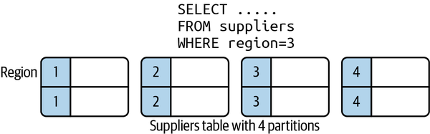
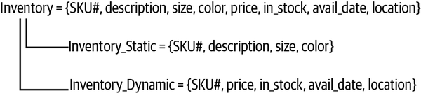
Scaling Databases
Scaling Relational Databases
Scale Out
Horizontal Partitioning Data
Vertically Partitioning Data (Normalization)
Challenges
Data split across multiple tables
Queries need to JOIN data from multiple tables
Distributed JOINs are complex to scale
Minimize data movement
Minimize latencies
Notes:
Splitting up, or partitioning data in a relational database, is a technique for distributing the database over multiple independent disk partitions and database engines.
In general, there are two strategies: horizontal partitioning and vertical partitioning.
Horizontal partitioning splits a logical table into multiple physical partitions. Individual rows are allocated to a partition based on some partitioning strategy. Common partitioning strategies are to allocate rows to partitions based on some value in the row, or to use a hash function on the primary key. As shown in Figure 10-3, you can allocate a row to a partition based on the value of the region field in each row.
Vertical partitioning, also known as row splitting, partitions a table by the columns in a row. Like normalization, vertical partitioning splits a row into one or more parts, but for the reasons of physical rather than conceptual optimization. A common strategy is to partition a row between static, read-only data and dynamic data.

Slide 7
Moving to NoSQL
Changes in Database Industry
Low-cost powerful hardware
Unstructured data types
Internet drives need for scalability
NoSQL Emerges
Simplified data models
Proprietary query languages
Limited/no JOIN support
Natively designed to scale horizontally
Notes:
The development of powerful, low-cost, commodity hardware, including multicore CPUs, faster, larger disks, and increased network speeds.
The emergence of applications that dealt with unstructured data types and rapidly evolving business and data models. No longer was the “one size fits all” approach of relational adherents applicable to these new use cases.
Increased need for scalability and availability for internet-facing applications.

Slide 8
Moving to NoSQL
Relational Data Models
Normalized data schemas
Single entry for every data item
JOIN tables to handle a huge range of possible queries
NoSQL Data Models
Model the solution
Efficient data organization to handle common queries
Data model prejoins data to provide rapid responses
‘denormalized data model’
Notes:
Data model normalization, as encouraged by relational databases, provides a proven technique for modeling the problem domain.
It creates models with a single entry for every data item, which can be referenced when needed.
Due to the power of SQL and joins, you don’t have to think too hard about all the weird and wonderful ways the data will be accessed, both immediately and in the future.
Your normalized model should (in theory) support any reasonable query for the application domain, and SQL is there to make it possible.
NoSQL Data Models
Solution domain modeling requires you to think about the common data access patterns the application must support, and to devise a data model that supports these accesses
For reading data, this means your data model must pre join the data you need to service a request
Essentially, you produce what relational modelers deem a denormalized data model. You are trading off flexibility for efficiency.

Slide 9
Moving to NoSQL
Example: Relational Model
SnowSportPerson = {ssp_id, ssp_name, address, dob, ……….}
Resort = {resort_id, resort_name, location, …..}
Visit = {ssp_id, resort_id, date, numLifts, vertical, …..}
Weather = {resort_id, date, maxtemp, mintemp, wind, …}
Example: NoSQL Model
VisitDay = {date, resort_name, ssp_id, ssp_name, numLifts, vertical, maxtemp, mintemp, wind}
Notes:
In NoSQL data modeling, you create a data model that has the results the query needs all together in a table. As shown in the following, a VisitDay has all the data items needed to generate each line in the list above. You just have to sum the number of VisitDay objects in the results set to calculate the number of days for a single person.3
The SnowSportPerson, Resort, and Weather tables would remain unchanged from your original model. This means we have duplicated data across your logical tables. In this example, most of the data in these tables is write-once and never changes (e.g., weather conditions for a particular day), so duplication just uses more disk space—not a major problem in modern systems.

Slide 10
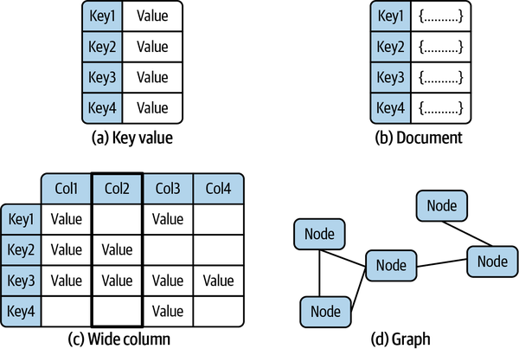
Moving to NoSQL
NoSQL Data Models

Slide 11
Moving to NoSQL
NoSQL Data Models
Key Value
Distributed Hash Map
Opaque data associated with each key. E.g. Redis, RedisRiak KV
Document
Each document in the database has a unique key.
Value is typically JSON or equivalent
Build indexes on document fields
Documents can be in different formats. E.g. MongoDB and Couchbase

Slide 12
Moving to NoSQL
NoSQL Data Models
Wide Column
Organizes data associated with a key in named columns
Essentially a two-dimensional hash map
Columns within a row uniquely identified and sorted using the column name.
Examples: Apache Cassandra and Google Bigtable
Graph
Treat relationships between database objects as first-class citizens
Enable a wide range of graph-based algorithms to be efficiently implemented.
Conceptually closest to relational databases
Examples: Neo4j and Amazon Neptune.
Notes:
- A wide column database extends the KV model by organizing data associated with a key in named columns. It’s essentially a two-dimensional hash map, enabling columns within a row to be uniquely identified and sorted using the column name. Like a document database, each row in a collection can have different columns. Apache Cassandra and Google Bigtable are examples of wide column databases.

Slide 13
Moving to NoSQL
Query languages
Proprietary
API based
SQL-like
Broad support for client libraries
Vendor and independent suppliers
Wide range of languages
Notes:
NoSQL database query languages are nearly always proprietary to a specific database, and vary between explicit API-based capabilities and SQL-like declarative languages.
Client libraries in various languages, implemented by the vendor as well as third parties, are available for utilization in applications.

Slide 14
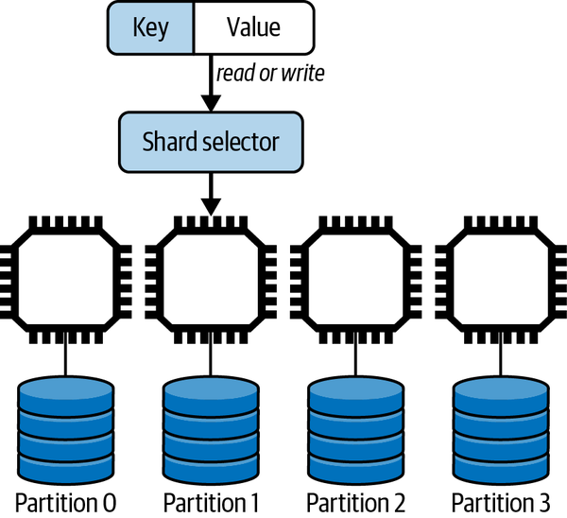
Partitioning
Designed to scale horizontally
Shared nothing architecture
No SPoF
Enhances performance/scalability
Graphs are an exception
Sharding approaches
Hash Key Based
Value Based
Range Based
Notes:
NoSQL databases are in general designed to natively scale horizontally across distributed compute nodes equipped with local storage.
Partitioning, commonly known as sharding, requires an algorithm to distribute the data objects in a logical database collection across multiple server nodes.
Ideally, a sharding algorithm should evenly distribute data across the available resources. Namely, if you have one hundred million objects and ten identical database servers, each shard will have ten million objects resident locally.
Sharding requires a shard or partition key that is used to allocate a given data object to a specific partition. When a new object is created, the shard key maps the object to a specific partition that resides on a server. When a query needs to access an object, it supplies the shard key so the database engine can locate the object on the server it resides
Hash key
The partition for any given data object is chosen as the result of applying a hash function to the shard key. The result of the hash is then mapped to a partition. There are two main ways of doing this, using a modulus approach or an algorithm known as consistent hashing.
Value-based
The partition is chosen based on the value of the shard key. For example, you might want to partition your data on customers based on their country of residence. Choosing the country field as the shard key would ensure all data objects for customers who live in China reside in the same partition, all Finland customers are allocated to the same partition, and so on.
Range-based
Partitions host data objects where the shard key resides within a specific range of the shard key value. For example, you might use zip code/post code ranges to allocate all customer objects who reside in the same geographical area to the same partition.

Slide 15
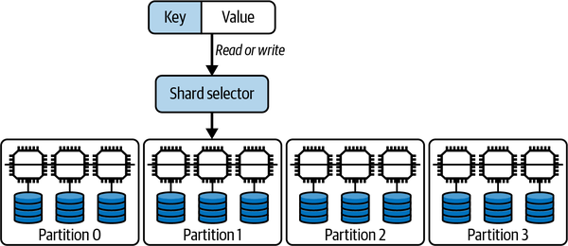
Replication
Replica Consistency
Need to keep replicas consistent
Update applied to all copies
Immediately?
With a lag?
Two basic architectures
Leader-Follower
Leaderless

Slide 16
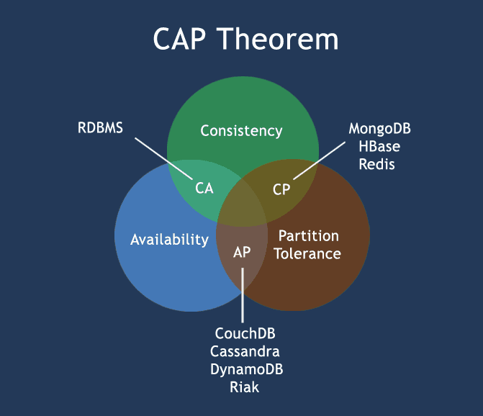
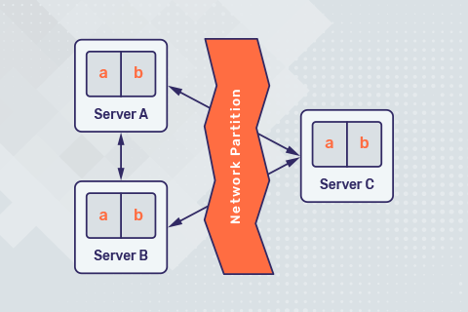
CAP Theorem
Notes:
Eric Brewer’s famous CAP theorem elegantly encapsulates the options you have for replica consistency and availability when utilizing distributed databases. It describes the choices a database system has if there is a network partition, namely when the network drops or delays messages sent between the nodes in the database.
Basically, if the network is operating correctly, a system can be both consistent and available. If a network partition occurs, a system can be either consistent (CP) or available (AP).

Slide 17
Questions?

